Slide 1


MODERATED USABILITY EVALUATION
Alyissa Sanders
Danielle Wanke
Marc Barton
Trevor Mickelson

Slide 2
OVERVIEW
Introduction
Who are we?
Why did we conduct this study?
What information will we cover in this presentation?
Methods
How did we collect our data?
How did we measure our data?
Findings
How well did the site perform for each task?
What recommendations can we make?

Slide 3
INTRODUCTION
Who are we?
A brief introduction of the group
Why did we conduct this study?
Our purpose and goals
What will we cover in this presentation?
A roadmap of our presentation

Slide 4

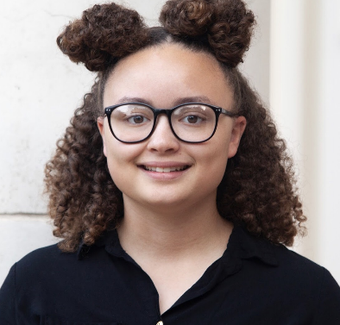

WHO ARE WE?
INTRODUCTION
METHODS
FINDINGS
Marc Barton
Technical Communication
Alyissa Sanders
Computer Science
Danielle Wanke
Technical Communication
Trevor Mickelson
Computer Science
We’re four students attending the University of North Texas
We’re enrolled in a UX and Usability course

Slide 5
WHY DID WE CONDUCT THIS STUDY?
INTRODUCTION
METHODS
FINDINGS
Our goal was to evaluate the Usability of ParkDental.com.
We conducted Moderated Testing Sessions to rate the usability of several site features.
In this presentation, we’ll detail our research methods, findings, recommendations, and research deliverables.
“[Usability is] the extent to which a product can be used by specified users to achieve specified goals with effectiveness, efficiency and satisfaction in a specified context of use.”
–Interaction-Design.org

Slide 6
METHODS
How did we collect our data?
A summary of our methods
What did we test?
The tasks we used to evaluate Park Dental’s site features
How did we measure success?
Our task-success scale

Slide 7
HOW DID WE COLLECT OUR DATA?
INTRODUCTION
METHODS
FINDINGS
We conducted Moderated Testing sessions with 8 participants, which included the following:
Asking Preliminary Questions to ensure that each participant had prior experience using dentist’s office websites.
Observing as each participant completed 4 tasks using the Park Dental website, with one person taking notes and another moderating the session.
Asking follow-up questions about the test after completion.

Slide 8
HOW DID WE COLLECT OUR DATA?
INTRODUCTION
METHODS
FINDINGS
We asked the following Preliminary and Follow-up questions to participants during the sessions:
Preliminary Questions
How often do you see the dentist?
Why do you visit your dentist’s website?
How often do you access the website for a doctor?
What device do you use to access their website?
Follow-up Questions
Which task did you have the most trouble with?
What is one thing about the website you wish you could improve?
How does this website compare to other Medical websites that you have visited?
What was your favorite part of this website?

Slide 9
WHAT DID WE TEST?
INTRODUCTION
METHODS
FINDINGS
Our participants completed the following tasks using Park Dental’s site features:
Task 1: Find an Event | Navigate to the Event calendar. Find the event “Harvest Festival”. What date will this event take place?
Task 2: Find Career Opportunities | Find the current career opportunities. Determine if there are Dental Assistant opportunities at any of the Park Dental locations in Wisconsin.
Task 3: Make an Appointment | Find the nearest Park Dental location and request an appointment for a Monday afternoon.
Task 4: Find a Dentist | Find a Dentist near Hudson, Wisconsin (zip code 54016) who provides Invisalign services. Then, find more information about them.
Table 1: Moderated Testing Tasks

Slide 10
HOW DID WE MEASURE SUCCESS?
INTRODUCTION
METHODS
FINDINGS
We rated each participant’s completion of each task on a scale of 0-2.
Tasks consistently rated lower than 2 signaled areas with room for improvement.
0 | The task could not be completed
1 | The task was completed with difficulty/assistance
2 | The task was completed easily
Table 2: Success Rating Scale

Slide 11
FINDINGS
What did our participants say?
Participants’ responses to follow-up questions
Self-reported data from our participants
How did we rate our findings?
How did we rate the success/failure of each task?
How did we determine issue severity?
Individual task summaries
How well did the site perform for each task?
What recommendations can we make?

Slide 12
WHAT DID OUR PARTICIPANTS SAY?
INTRODUCTION
METHODS
FINDINGS
After each testing session, we asked participants several questions about their experience with the site.
Below are some notable responses to our follow-up questions:
Which task did you have the most trouble with? | Most participants reported the first task, Find the Event Calendar.
What is one thing about the website you wish you could improve? | Participants suggested simplifying the main menu bar by reducing the number of options, or removing the scrolling animations from the home page, as they were distracting and affected load times.
What was your favorite part of this website? | Features mentioned here included the following: The site’s organization The Make an Appointment window The general aesthetic/color scheme
Table 3: Follow-up Question Responses

Slide 13
WHAT DID OUR PARTICIPANTS SAY?
INTRODUCTION
METHODS
FINDINGS
This chart displays the average difficulty of each task, as rated by our participants.
Ratings were measured on a scale of 1 to 7, with 7 being extremely difficult and 1 being extremely easy.
Figure 1: Average Difficulty Rating by Task

Slide 14
HOW DID WE RATE OUR FINDINGS?
INTRODUCTION
METHODS
FINDINGS
This chart measures the success rating of each of our tasks, by participant.
Gaps between bars represent a rating of 0.
Figure 2: Average Completion Time by Task

Slide 15
HOW DID WE RATE OUR FINDINGS?
INTRODUCTION
METHODS
FINDINGS
This chart displays the average amount of time each task took to be completed across all participants.
As corroborated by our findings so far, you can see here that the most time-consuming task, on average, was the first one (Find the Event Calendar).
Figure 3: Average Completion Time by Task

Slide 16



HOW DID WE RATE OUR FINDINGS?
INTRODUCTION
METHODS
FINDINGS
We rated the severity of our findings using the symbols below. Ratings are based on issue frequency, and the amount that each issue distracted participants from completing the task.
Major Issue
The site element caused participants to give up/fail a task
Minor Issue
The site element negatively affected the site’s usability
Positive Finding
The site element positively affected the site’s usability

Slide 17
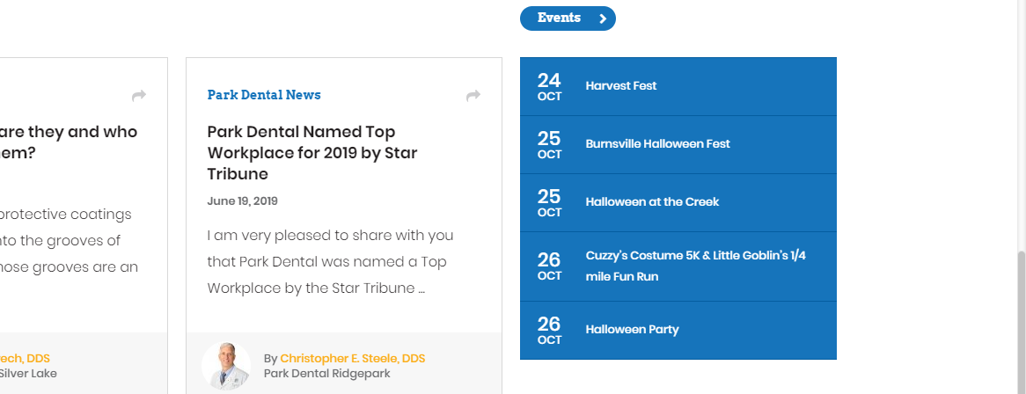
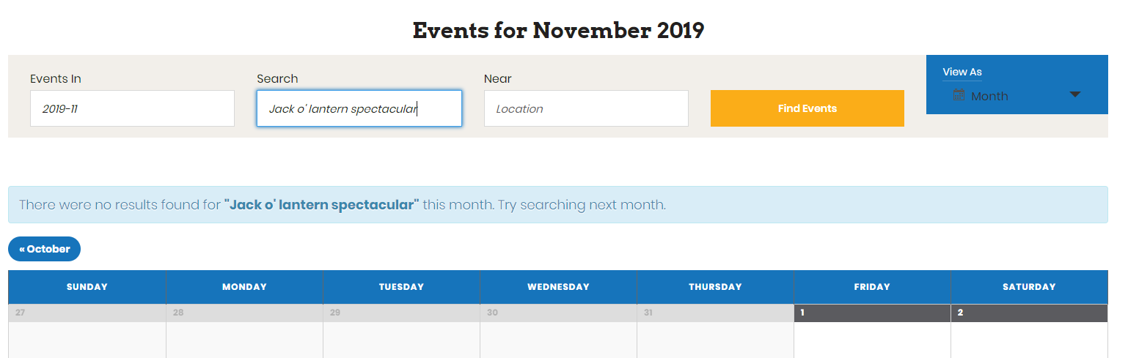
INDIVIDUAL TASK SUMMARY
INTRODUCTION
METHODS
FINDINGS
Task 1: Find an Event on the Calendar
Finding 1: Major Issue
Out of 8 participants, 5 had difficulty finding the event calendar on the homepage; it was pushed to the very bottom.
Recommendation:
Move the Event Calendar to the Main Menu bar so that users can find it more easily.
1.
Finding 2: Minor Issue
Several participants had trouble finding the requested event using the calendar’s Search feature because it could only search within the currently selected month.
Recommendation:
Modify the calendar’s Search feature to search for events over multiple months so that users can use it to find past/future events.
2.

Slide 18
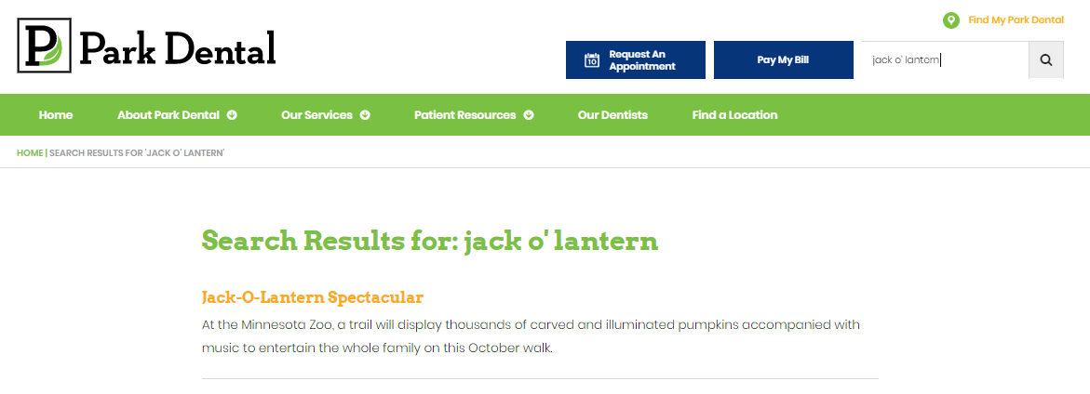
INDIVIDUAL TASK SUMMARY
INTRODUCTION
METHODS
FINDINGS
Task 1: Find an Event on the Calendar
Finding 3: Positive Finding
2 out of 8 participants searched for the event in the site’s main search bar, leading them to the correct page.
While this feature could not be used to find events they didn’t already know about, it did demonstrate flexibility in the site’s navigation options.
3.

Slide 19
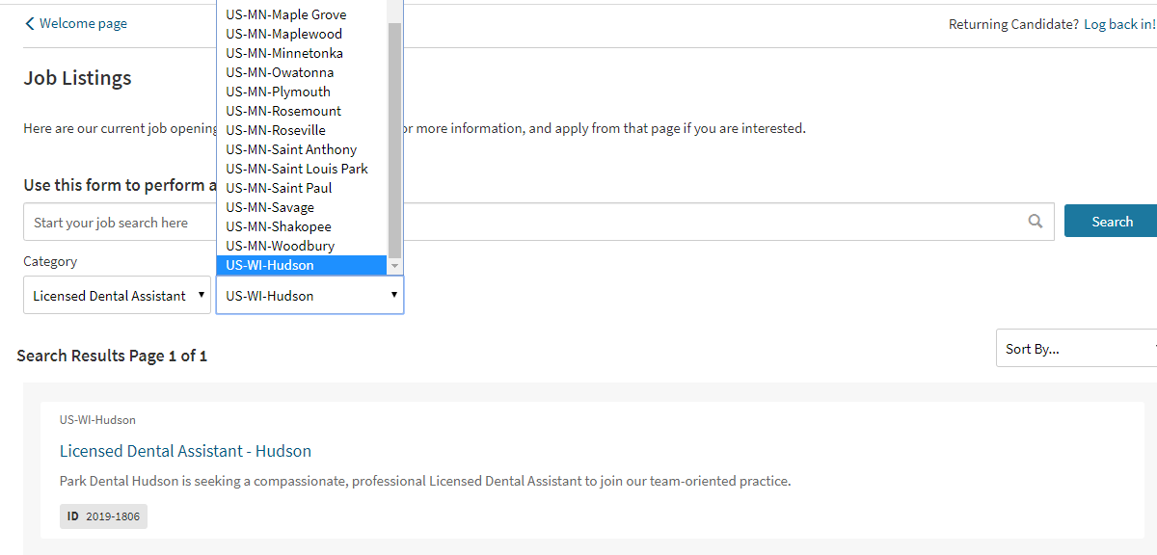
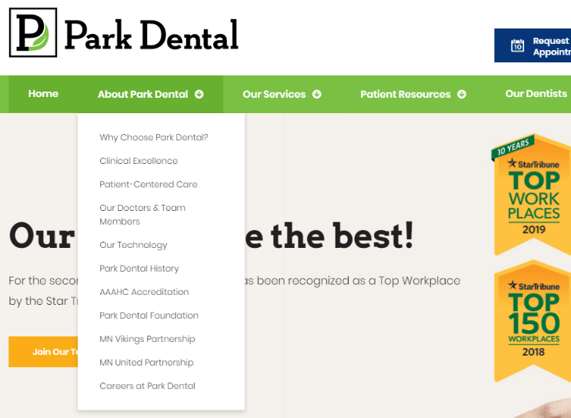
INDIVIDUAL TASK SUMMARY
INTRODUCTION
METHODS
FINDINGS
Task 2: Find Career Opportunities
Finding 4: Minor Issue
3 participants reported difficulty finding job postings for Wisconsin due to its placement at the bottom of the locations drop-down menu.
Recommendation:
Include an interactive map like, the one on the Find a Location page, or a zip-code search field so that users can find nearby opportunities more easily.
4.
Finding 5: Positive Finding
Participants had no trouble locating the Careers page—it was easily accessible from a drop-down on the site’s main menu bar.
5.

Slide 20
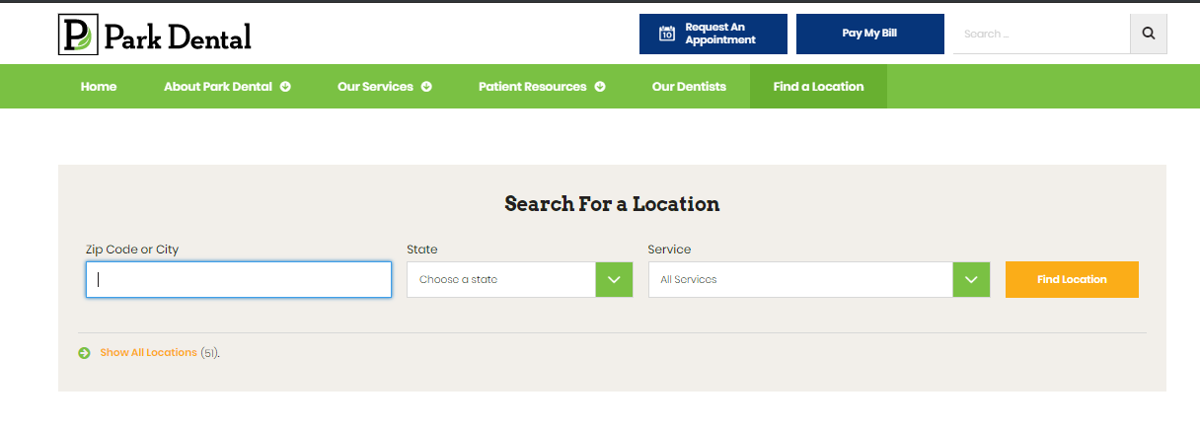
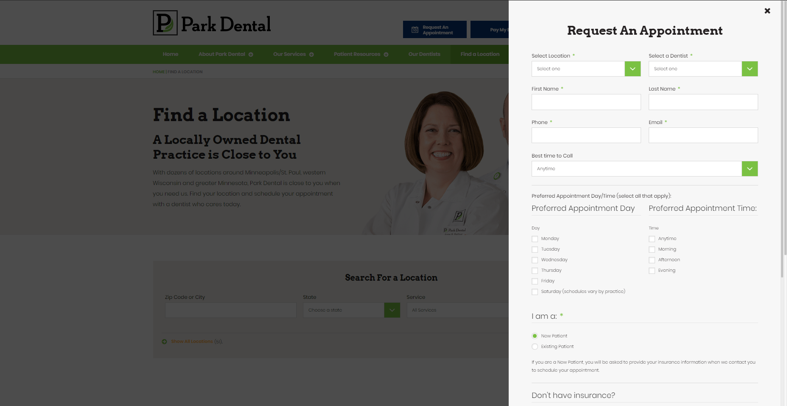
INDIVIDUAL TASK SUMMARY
INTRODUCTION
METHODS
FINDINGS
Task 3: Make an Appointment
Finding 6: Major Issue
3 participants reported difficulty using the Request an Appointment button on the menu bar—unlike on the Find a Location page, it provides no option to search for nearby locations.
Recommendation:
Include a zip code/city search bar in the Request an Appointment pop-up window so that customers can find nearby locations without already knowing where every Park Dental location is.
6.
7.
Finding 7: Positive Finding
The Request an Appointment window was otherwise user friendly.
One user commented on the convenience of the window opening separately, which allowed them to return quickly to the page they were just on.

Slide 21
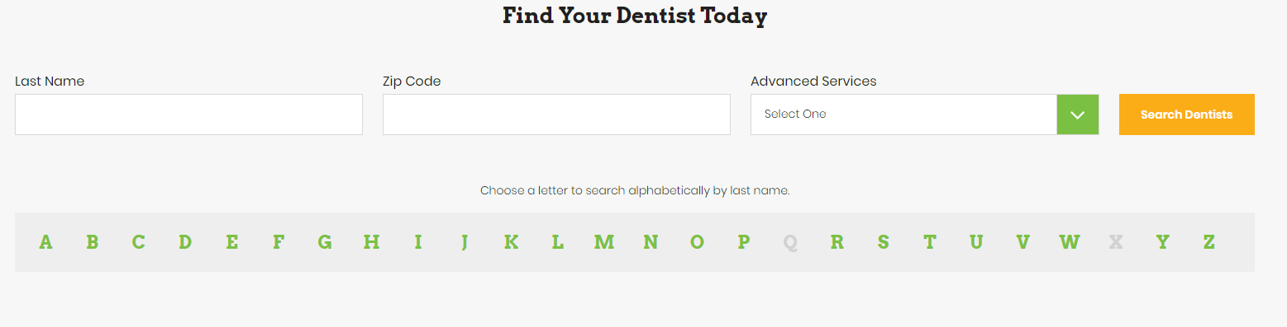
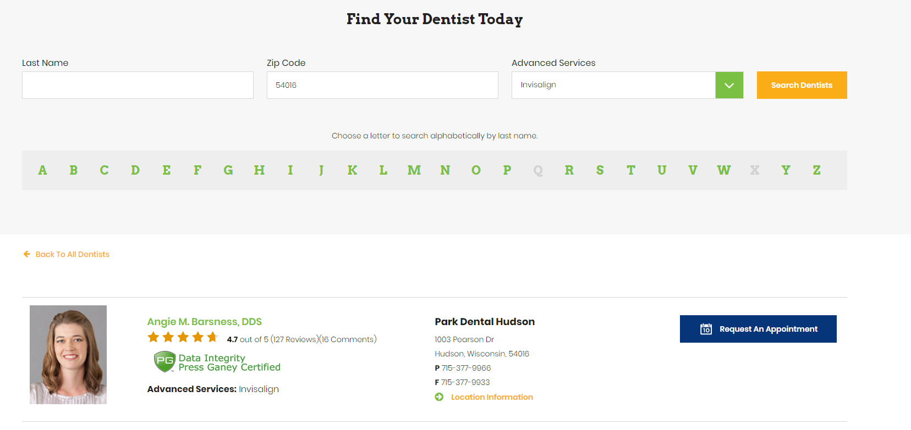
INDIVIDUAL TASK SUMMARY
INTRODUCTION
METHODS
FINDINGS
Task 4: Find a Dentist
8.
Finding 8: Minor Issue
One participant, who was less confident navigating webpages, was confused by the Dentist Search setup. They thought, based on the layout, that they would have to fill out every entry field before they could search, which nearly prevented them from completing the task.
Recommendation:
Provide a disclaimer near the search fields specifying that not all fields must be filled out to use the search feature.
2.
Finding 9: Positive Finding
The Our Dentists page/search feature was easily accessible from the main menu bar, and no other participants had trouble finding a dentist by the Zip Code and Advanced Services fields.
The dentist bio pages were also easy to navigate once found; no participant had an issue finding relevant information on the page.
9.

Slide 22
Thank you for your time.

